Slide 1
Challenges in Supply Chain Management for Advanced Reactors – the UK Experience
Keith Collett, CEO Nuvia Limited, Deputy CEO Nuvia Group

Slide 2

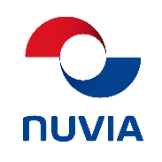





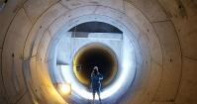
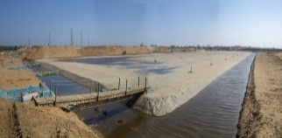



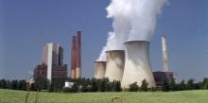
Nuvia is part of VINCI: The World’s Leading Construction & Concessions Company
2016 Revenue: 38.1 bn €
Workforce: 183 487
14.5 bn €
Workforce 68 371
Revenue: 3 bn €
Workforce: 22 800
Revenue: 1 525 M€
Workforce : 10 300
Revenue: 250 M€
Workforce : 1 000
Revenue: 215 M€
Workforce : 800
Revenue: 750 M€
Workforce : 7 500
Revenue: 69 M€
Workforce : 600
Revenue: 358 M€
Workforce : 2 700
SOILS
STRUCTURES
INFRA STRUCTURES
NUCLEAR

Slide 3


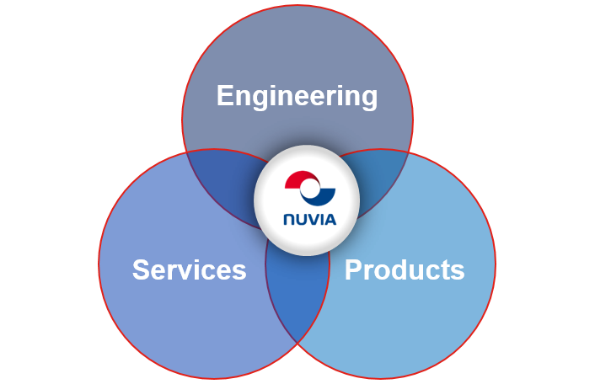




Nuvia Group
Key Areas of Activity:
Consultancy
Supporting the full Lifecycle
Design and Build
Decontamination
Decommissioning
Concept Design
/ Optioneering
Plant Life Extension
Plant Life
Extension
Engineering /
Design
Operations and Maintenance
Operations &
Maintenance
Decommissioning
Procurement /
Manufacture
Commissioning
and Testing
Construction /
Installation
Radiation Protection
Waste Management
Products

Slide 4
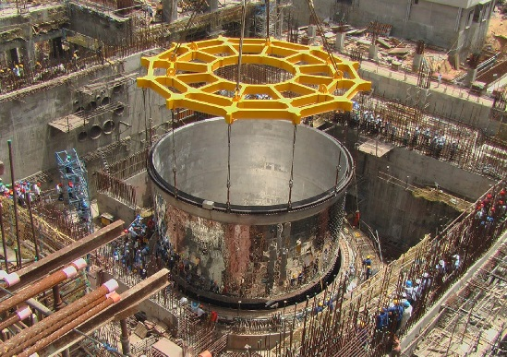
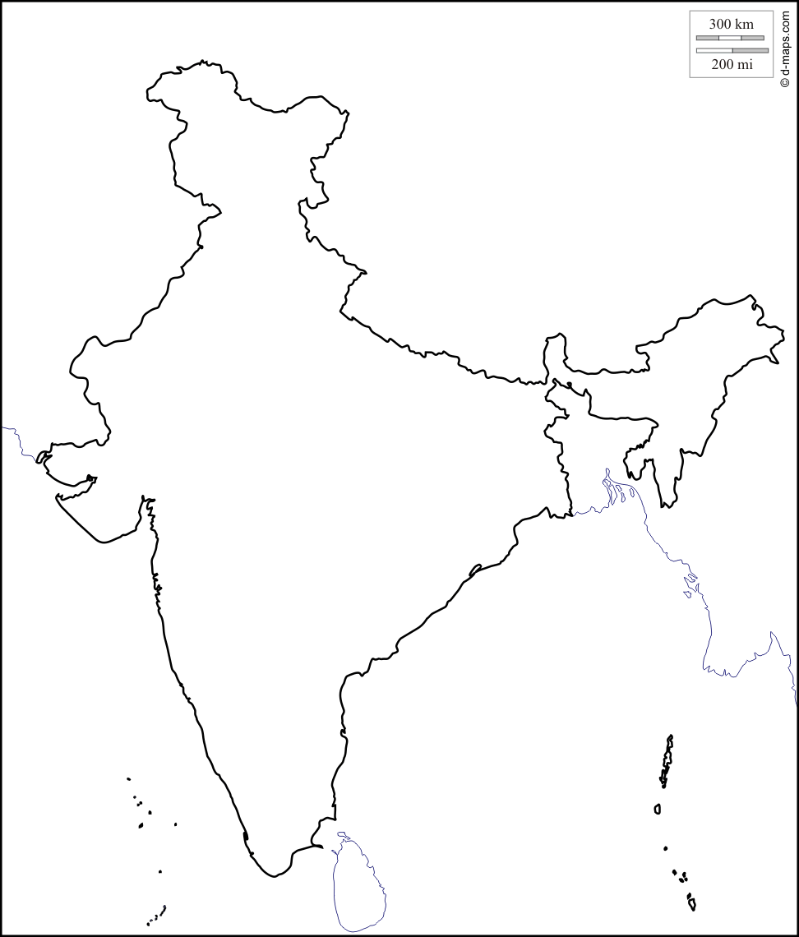

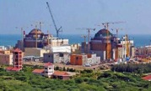
NUVIA India
Managing Director:
Minu Singh
Head Office: New Delhi
Established 2011
New Delhi
Nuvia India Projects
New Build
  DM water plant for
  Passive fire protection
Plant Life Extension
  Snubber refurbishment
Operations
  Instrument Calibration & Maintenance
  Radiation protection
Decommissioning & Waste Management
  Waste clearance for an industrial company
Training
  Radiation Protection
  NORM management
ACTIVITIES
New Build
Plant Life Extension
Operations
Health physics
Waste Management

Slide 5
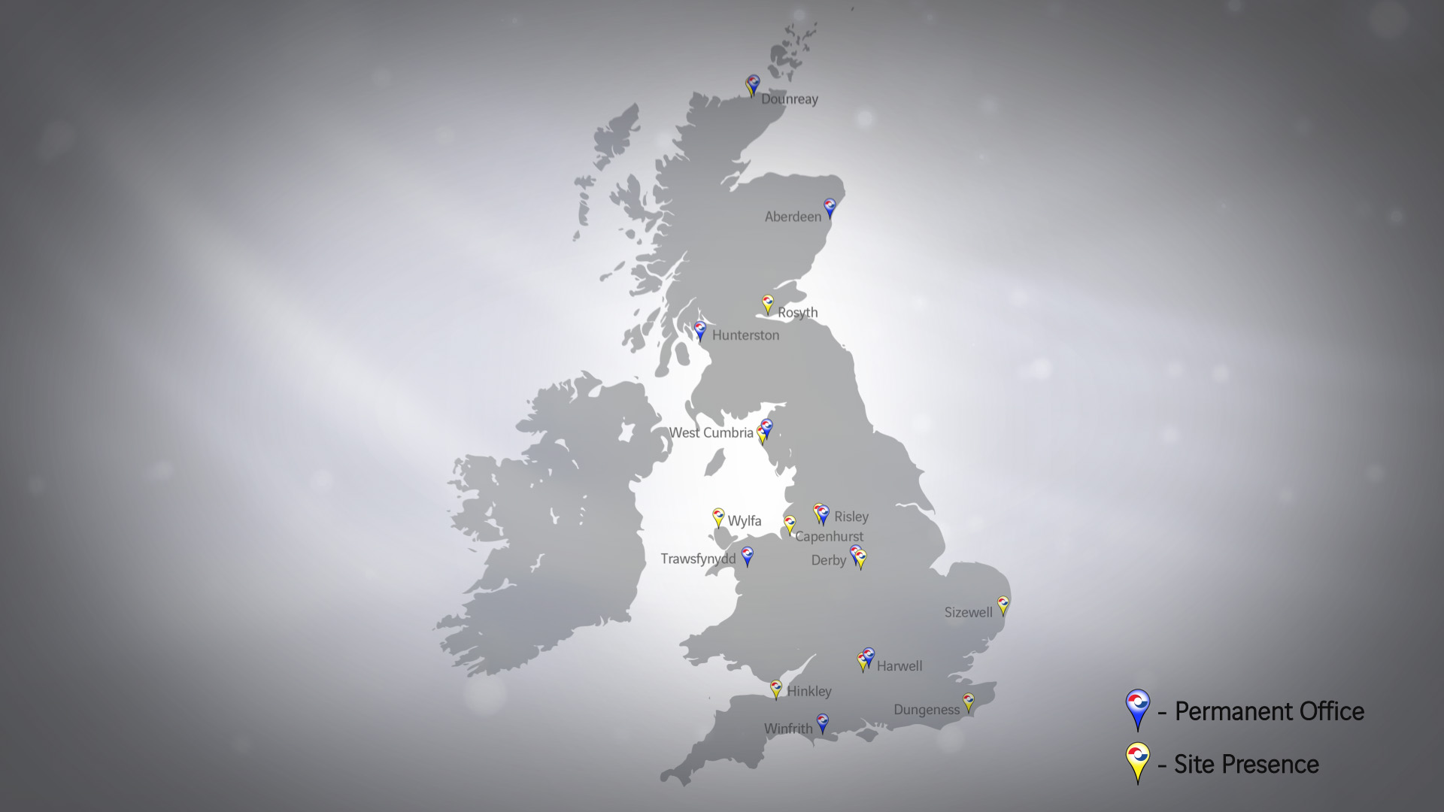
Nuvia UK
Nuvia is located across the UK
Our locations are close to nuclear sites to enable us to respond quickly
We have circa 1000 Nuvia personnel based in the UK supporting nuclear projects
Notes:
Numerous locations in the UK, typically close to client sites.
Over 900 employees in the UK
In recent years we have diversified into a number of new geographical locations in the UK, linked closely to our business strategy objectives of leading our markets and providing a diverse offering to our clients.
Including new markets / locations in recent years:
1) New Build development: Hinkley with EDF, Horizon at Wylfa and with NuGen at Sellafield.
2) SMR contracts
3) CNS at Capenhurst

Slide 6
UK New Build: Key Locations
Moorside
Wylfa
Manchester
Hinkley
London
Notes:
Numerous locations in the UK, typically close to client sites.
Over 900 employees in the UK
In recent years we have diversified into a number of new geographical locations in the UK, linked closely to our business strategy objectives of leading our markets and providing a diverse offering to our clients.
Including new markets / locations in recent years:
1) New Build development: Hinkley with EDF, Horizon at Wylfa and with NuGen at Sellafield.
2) SMR contracts
3) CNS at Capenhurst

Slide 7
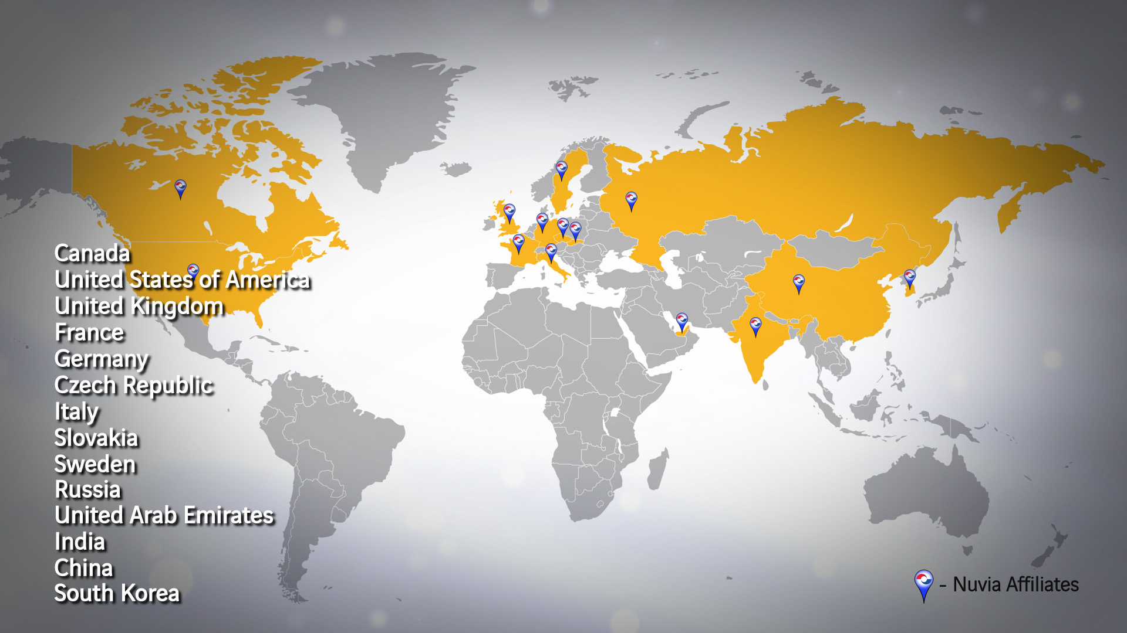
Nuvia Group
Nuvia is an international organisation with offices located across the globe
We have a diverse, international client base who all have unique challenges
Our global outlook enables us to invest our resources to best support our clients

Slide 8
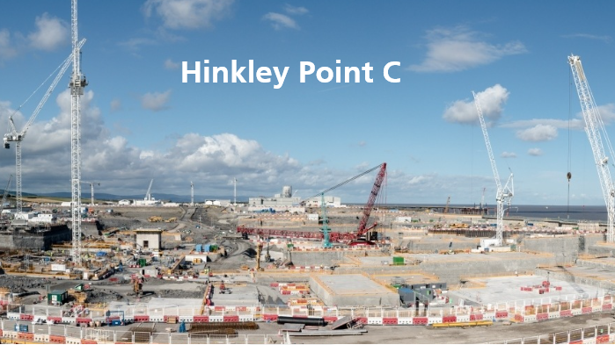
Challenges in Supply Chain Management for Advanced Reactors – the UK Experience

Slide 9
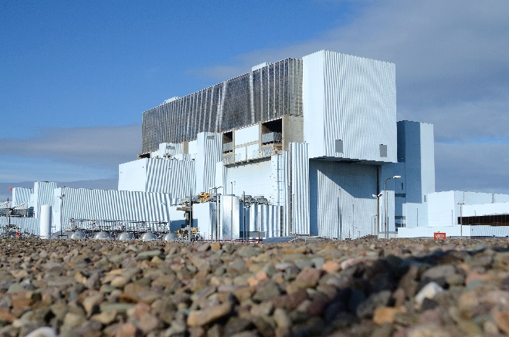
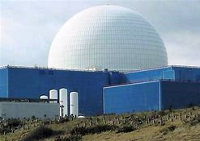
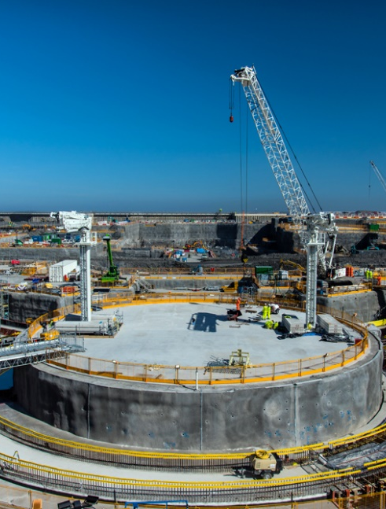
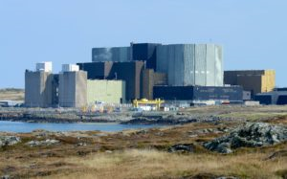
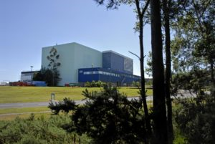
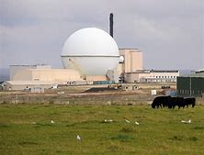
Reactor Types
UK has eperience in a very wide range of reactor types
However there has been no new build for over 20 years
Regulatory Requirements
Need to meet new regulatory process (GDA) to support developers
Understanding impact of overseas regulations and codes e.g. RCCM
Resources
Expand nuclear manufacturing capability
Reinvigorate nuclear training and skills
Challenges for the Supply Chain
Notes:
The diversity of the past, current and future reactor plant in the UK has demanded a flexible supply chain capable of assimilating new technologies while maintaining the basis of safe and effective operation. You can see the range of reactors, gas cooled, high temperature, PWR, heavy water and fast reactors which have contributed to the development of UK nuclear expertise. It may also be worth noting that this expertise has also been deployed extensively in other countries, for example Nuvia is extensively involved in supporting the nuclear programme in Canada with its CANDU reactors and assisting Bulgaria programme in dealing with the decommissioning of its VVER units.
Given this diversity the supply chain has had to rapidly assimilate a range of new regulatory requirements, such as the Generic Design Approval process, and design requirements such as RCCM for the EPR.
This demand has put a strain on both the human and physical resources available and needed a determined effort by companies to develop and expand their capabilities.

Slide 10
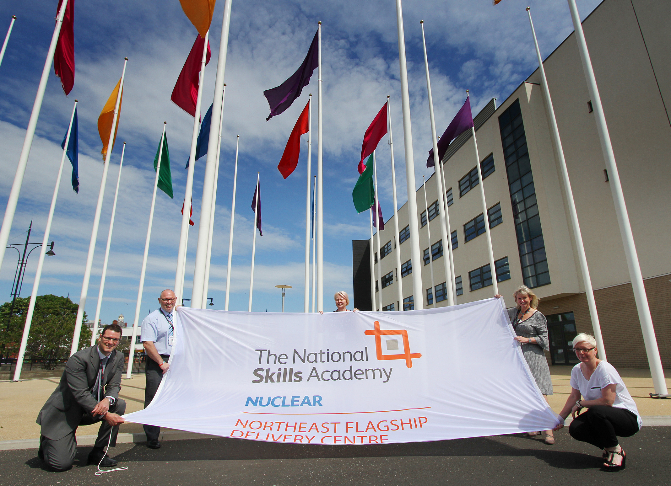
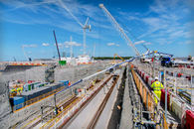



Reactor Types
Developing a wider base of experise in current recator types, EPR, ABWR, AP 1000, HPR 1000
Responding to construction requirements for Hinkley Point C
Regulatory Requirements
Working with developers to meet the requirements of the GDA
Developing overseas partnerships to meet design and manufacturing requirements
+
Nuclear Doors
Resources - Investment by UK Government
Nuclear Advanced Manufacturing Research Centre
National Nuclear Skills Academy
Fit for Nuclear
Meeting the Challenges
Notes:
These challenges are being met in a number of ways.
Developing a knowledge of the similarities and differences of the various reactor types to provide a flexible workforce that can provide for the requirements of today while looking to future deployment and operation.
Looking at new teaming arrangements where the strengths of different parties can be combined to deliver key nuclear components. These are often international collaborations. For example Nuvia teamed with Sommer from Germany for the supply of nuclear doors for Hinkley Point C., combining the design and manufacturing capability of Sommer with the local engineering and installation expertise of Nuvia.
Getting leverage from various Government initiatives to support the supply chain such as the Nuclear Advanced Manufacturing Research Centre, where Nuvia is an industrial sponsor, to the Nuclear Skills Academy promoting expansion of the qualified workforce particularly through apprenticeships, to the Fit For Nuclear certification programme to bring new companies into the nuclear market.

Slide 11
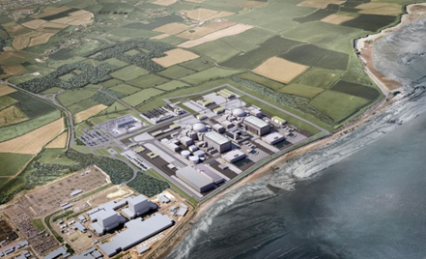
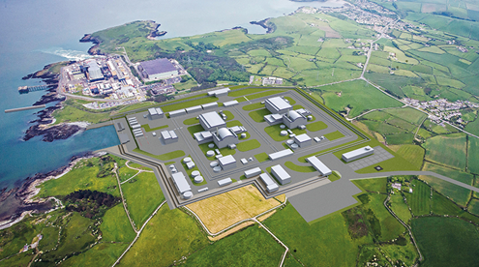
Some Example Projects Supporting UK New Build

Slide 12




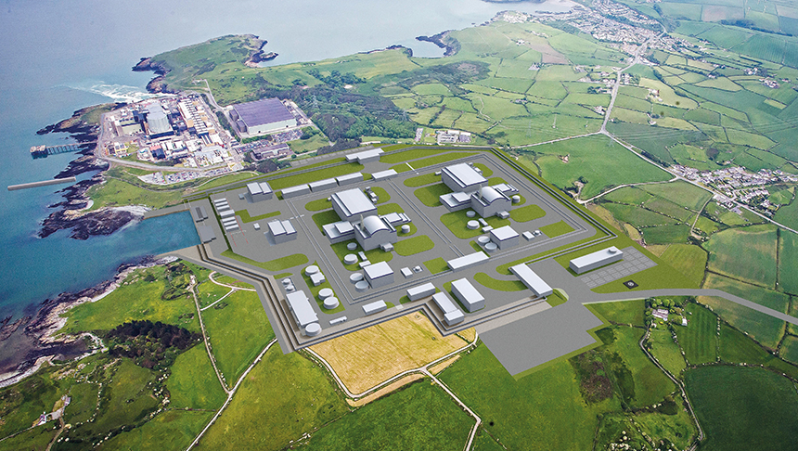
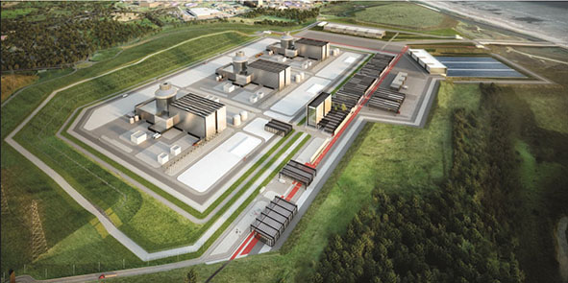

New Nuclear Build in the UK
Hinkley Point C Site – EPR
Wylfa Site – ABWR
Moorside Site – ?
Under construction
Generic Design Assessment achieved
Under review
Notes:
In the following slides you can see how the requirements of the regulator and the Government in the UK have made demands on the supply chain at various stages in the development power programme. Here we have the three leading developments now at different stages where Nuvia is providing EPC capabilities for the delivery of nuclear systems for the EPR at Hinkley, consulting advice for the GDA of the ABWR for Wylfa and the NuGen Moorside project while it is under review. The latter may involve a change of reactor type before it progresses.

Slide 13


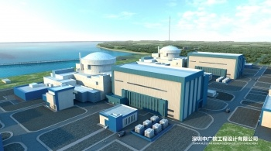
New Nuclear Build in the UK
Bradwell B Site –UK HPR1000
UK Advanced Modular Reactor
The Department for Business, Energy and Industrial Strategy (BEIS) is investing up to £44 million to establish an advanced modular reactor (AMR) feasibility and development programme.
AMRs are defined as a broad group of advanced nuclear reactors. AMRs differ from conventional reactors, which use pressurised or boiling water for primary cooling. They aim to maximise the amount of off-site factory fabrication and have increased functionality
CGN / EdF joint Venture
Technical Assessor
Notes:
In addition there are some additional challenges which the UK industry is facing in the proposed introduction of an unfamiliar reactor type, the HPR 1000 from CGN, China. This may be analogous to the introduction of VVER technology into the Indian market and perhaps there are things that the UK can learn from how India has managed the process.
The UK Government also envisages a long term future for the UK nuclear industry both domestically and internationally not only providing expertise but also at the forefront of advanced technology. To this end it has launched a development initiative for the introduction of Advanced Modular Reactors

Slide 14



Generic Design Assessment (GDA) – Experience
Mechanical Engineering
Process Engineering
Internal / External Hazards
Decommissioning
Embedded Pipe work design philosophy
Penetration design philosophy
RCCV shielding design for penetrations
Chemical engineering philosophy for plant and equipment
Initial Plant and Instrumentation Diagrams (P&IDs)
Peer review of PCSR Chapter 31 topic reports
Assessing the underpinning behind the Claims, Argument and Evidence (CAE) approach
Experience personnel with authorship of the PCSR of all three reactor designs:
EPR / ABWR / AP1000
Notes:
The introduction of advanced reactors into even established markets poses a range of issues not least to the regulatory authorities in dealing with developers who are unfamiliar with the established processes. The introduction of the Generic Design Assessment process was aimed at providing certainty to developers that new reactor types could be safely introduced into the UK market. However considerable effort is required to meet the requirements of the Regulator across the whole spectrum of nuclear operations and this and the following slide illustrate the work that Nuvia has and is doing to support the various reactor vendors.

Slide 15

GDA – Experience continued
Radiation Protection Support
Ventilation Design
Safety Case Production
Radioactive Waste Management
Radioactive waste management design
Initial designs from basic requirements through to concept and scheme design
Currently supporting site specific PCSR design
Complete design of the vessel ventilation systems relating to the radioactive waste systems
Includes plant and equipment layouts and configurations for optimised site layout
Radiation Protection Advisors (RPAs) supporting design and safety meetings (e.g. HAZOPs).
Established framework support to the ONR
Production of radioactive waste systems safety case including HAZOP & BAT reviews
Direct support and guidance on regulatory review sessions
Notes:
While Westinghouse and Hitachi have now completed the GDA process any further proposed reactor, such as the HPR 1000 and any new advanced designs, will need to demonstrate how they will meet the requirements of the GDA.

Slide 16

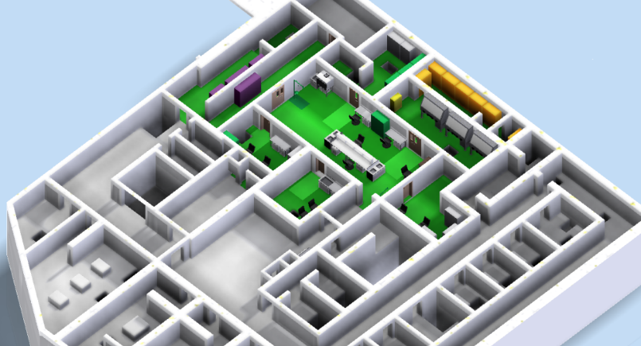
  Nuclear Sampling Systems
  Scope
EPC contract to design, procure, install, construct and commission the nuclear sampling system
  Complete design of the laboratory set up
  Each unit has its own dedicated sampling system
  Equipment includes: gloveboxes, analysers, small bore pipe work, valves and heat exchangers
  Challenges
  Major EPC contract involving many disciplines
  Design for 60-year lifetime
  Human factors challenge given spatial requirements
  Adapt existing design aspects to satisfy UK Regulatory requirements
  Outcome
  Nuvia recognised as best technical solution and most competitive offer
  Project delivery under design phases
  Full Engineer, Procure, Construct (EPC) systems
  for the EPR at Hinkley Point C
Notes:
Turning to current new build in the UK the EDF EPR at Hinkley Point C will be the first UK new build reactor in the last 20 years. Site construction is well established and contracts for major sub-systems have been let. The challenge for the UK supply chain has been demonstrating that it still has the capability and capacity to deliver on key elements in competition with an existing supply chain for EPR builds at Olkiluoto and Flamanville. I’m pleased to say the industry and Nuvia has risen to this challenge, winning packages such as the nuclear sampling system as illustrated here.

Slide 17
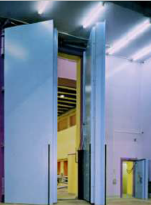
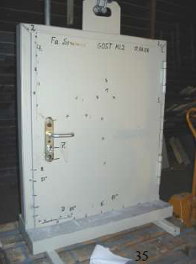

  Nuclear Doors
  Scope
EPC contract to design, procure, install and commission nuclear doors.
Door packages include:
  Aircraft protection doors Awarded
  Security doors Awarded
  Shielding doors Bidding
  Articulated hatches Bidding
  Partnership
  Strong existing relationship on an international scale
  Proven delivery of nuclear doors in the UK by Nuvia
  Full turn-key capability to design, procure, install, construct and commission nuclear doors
Notes:
However it is clear that the UK supply chain cannot deliver all aspects of a new reactor build as some components are beyond current manufacturing capability. This is true of course of the reactor pressure vessel in particular, however the UK Government has encouraged the supply chain to re-invest in major component manufacture through initiatives such as the Nuclear Advanced Manufacturing Research Centre mentioned above.
Another approach is for the UK supply chain to form alliances with international suppliers to provide a complete delivery service. The example mentioned previously and illustrated here is Nuvia teaming with Sommer from Germany to supply the nuclear doors for HPC. Nuvia has also looked at teaming with Indian companies for manufacturing capability where quality and cost effectiveness can be combined to provide a competitive offer.

Slide 18
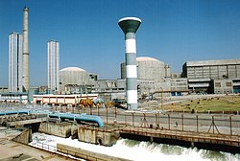
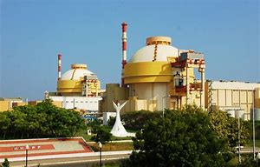
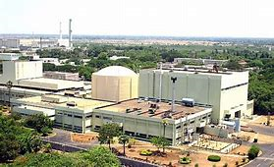
UK Supply Chain Experience Relevant to India’s New Build Programme
Developing a supply chain responsive to different reactor types
                LWR, HWR, Fast Reactor
                Responding to future requirements
    Integration of overseas reactor designs with local regulatory requirements and design requirements
      e.g. EPR, AP1000, VVER
      e.g. understanding RCCM, ASME and GOST
        Expanding the nuclear workforce
          Leveraging on overseas experience in collaboration with local suppliers
          Training and qualification using international experience, delivered locally
            Partnerships between UK and Indian companies
              Maximising value – expertise and cost
              e.g. Nuvia UK working with Nuvia India and local suppliers for the delivery of the Demineralized Water Plant for KAPS 3 & 4
Notes:
So how is this experience in the UK relevant to the nuclear expansion programme in India?
I think there are 4 main points that are relevant;
Firstly developing a supply chain that is not dependant on one reactor type where the basic capability can be adapted across the station types to ensure continuity in supply both for current and future developments
Secondly developing the expertise to have the flexibility to deal with the various overseas design codes utilised by the different reactor vendors, in India’s case French, American and Russian and the impact on meeting the Indian regulatory requirements.
Thirdly developing an expanded workforce to meet the demands of the reactor build and operations through initiatives in collaboration on knowledge exchange and training.
Finally building on partnerships to identify where value can be delivered through combining UK expertise with local delivery as we are doing for the demineralised water plant for KAPS 3 & 4 with Nuvia India and its local supply chain.

Slide 19
Thank You for Your Attention
Questions?

Slide 20
Keith Collett
Chadwick House, Birchwood Park, Risley
+44 1925 85 8226
Keith.collett@nuvia.co.uk
www.nuvia.co.uk

